Slide 1
Psychological Measurement

Slide 2
What is measurement?
Psychological Measurement – The assignment of scores to individuals so that scores represent some characteristic of the individuals
You weigh yourself by stepping on a scale.
You check the temperature with a thermometer.
You don’t need special instruments to measure something, just a systematic procedure for assigning scores to individuals.
Working Memory capacity (ability to hold and manipulate several items in mind at any given time)
You can measure working memory capacity using a digit span task
You start by reading a list of 2 items to a participant, and ask them to recite it backwards. --- gradually increase list length
Measure working memory by the maximum numbers they can correctly recite before making a mistake.

Slide 3
Constructs
Somethings are easy to measure. Other things in psychology aren’t directly observable – difficult to measure.
You can’t assess someone’s intelligence by looking at them as you might do for how tall someone is. You can’t tell anything about someone’s personality by looking at them. These are called constructs because they can’t be observed directly.
To measure intelligence:
g
Crystallized ability
Processing speed
Visuospatial ability
Memory

Slide 4
Operational Definitions
Operational definition – a definition of a variable in terms of precisely how it is going to be measured.
There are different categories (self-report measures, behavioral measures, physiological measures)
Self-report measures – people report on their own thoughts, feelings, or actions.
Behavioral measures – where some other aspect of participants’ behavior is observed and recorded (e.g. reaction time).
Physiological measures – recording a wide range of physiological processes – heart rate, galvanic skin response, brain activity
Not always one right/correct operational definitions

Slide 5

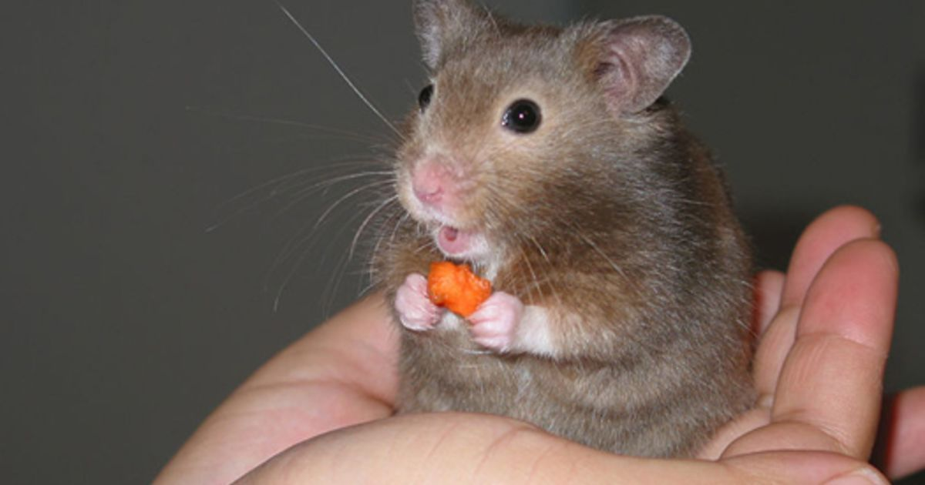


Operational Definitions
Examples:
Memory
Number of items recalled from a list
Cute Aggression
Number of packing bubbles popped while viewing pictures
Stress
Number of hairs pulled out of someone’s own head.
Anger
Number of times someone shouts at a person in 24 hours.

Slide 6

Levels of Measurement
Nominal
Categorical – M/F College/NotCollege Lefthand/Righthand
No order to it
Ordinal
Rank order
Strongly disagree – slightly disagree – slightly agree – strongly agree
Interval
No true zero. No ratios.
Ratio
True zero! Height and weight for instance…
C
F

Slide 7
Levels of Measurement examples
Identify the following as nominal, ordinal, interval, or ratio
Different flavors of chocolate
Number of pencils in your pencil holder
Letter grades on your Math test
Years of historical events
Religion
Nominal
Ratio
Ordinal
Interval
Nominal

